Slide 1
Artificial Intelligence
2: Rational Agents & DFS
Alvin Tjondrowiguno & Andre Gunawan

Slide 2
Recall: Acting Rationally
The Rational Agent approach. This approach aims to make computers that do the right thing. A rational agent is designed to achieve the “best” outcome in its environment, according to certain goals.

Slide 3
Agents and Environments

Slide 4
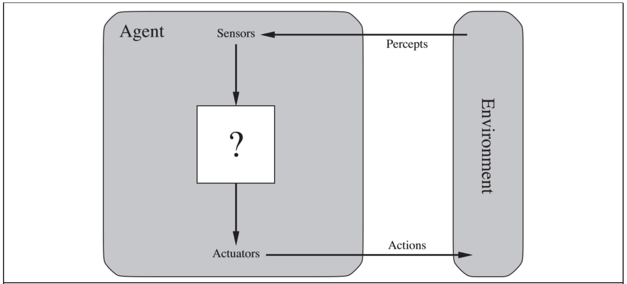
Agent
An agent is something that:
Perceives its environment through sensors
Acts upon its environment with actuators

Slide 5
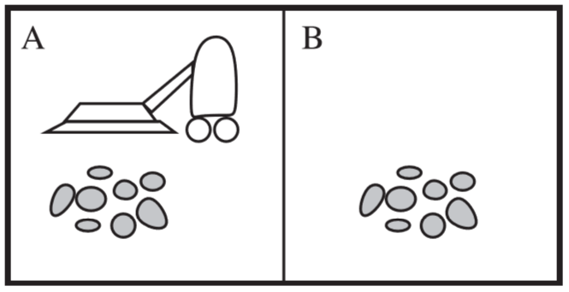
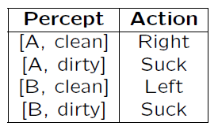
Agent Example: Vacuum Cleaner
Percepts: Location and Condition
Actions: Left, Right, Suck
Agent function: Mapping from percepts to actions

Slide 6
Rational Agents
A rational agent is an agent that does the right thing. Or conceptually, all entries in the agent functionality table are correct.
The rationality of an agent depends on 4 things:
Performance measure
Knowledge of the environment
All possible actions that the agent can perform with its actuators
The percept sequence the agent receives through its sensors

Slide 7
Rational Agents
Definition of a rational agent (Russel, Norvig):
“For each possible percept sequence, a rational agent should select an action that is expected to maximize its performance measure, given the evidence provided by the percept sequence and whatever built-in knowledge the agent has.”

Slide 8
Rational Agents
Performance measure: Over a lifetime of 1000 steps, each clean square at each time step awards one point
Environment: The two squares, location of the agent, and location of the dirt
Actions: Left, Right, Suck
Percept sequence: Location and Condition

Slide 9
Types of Agents

Slide 10
Types of Agents
There are 4 basic types of agents, with increasing complexity (and capability):
Simple reflex agents
Model-based reflex agents
Goal-based agents
Utility-based agents
In addition, there is another generalized type of agents, the Learning agents, which are capable of improving their performance through experience.

Slide 11
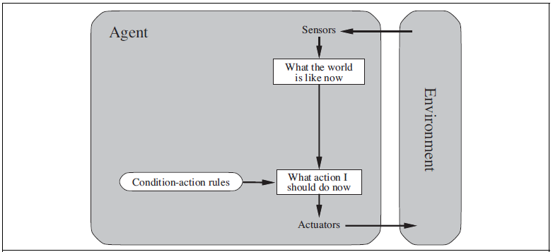
Simple Reflex Agents
A simple reflex agent:
Selects an action based only on the current percepts.
Is simple and limited.

Slide 12
Simple Reflex Agents: Example
Percepts: Location and Condition
Actions: Left, Right, Suck

Slide 13
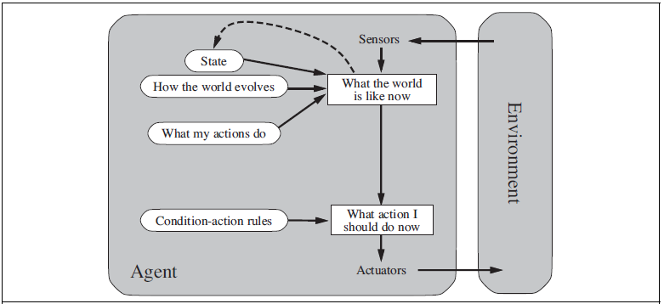
Model-Based (Reflex) Agents
A model-based agent:
Has a model of the world and its evolution, most commonly represented by states.
Chooses actions based on that internal model and its history.

Slide 14
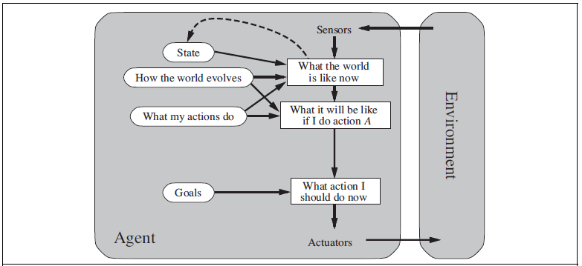
Goal-Based Agents
A goal-based agent:
Has knowledge about the environment state AND the agent’s goal.
Combines the goal and the environment model to choose actions.

Slide 15
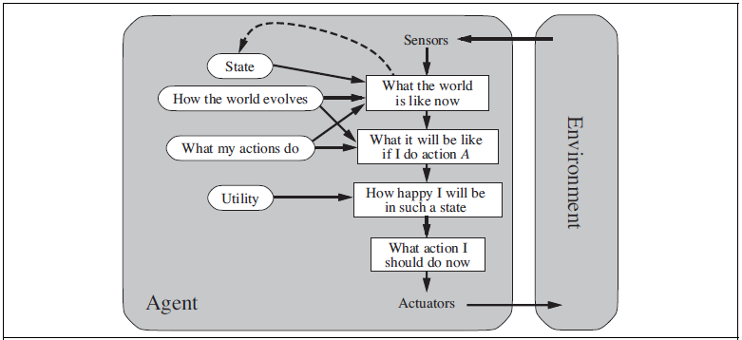
Utility-Based Agents
A utility-based agent:
Has the information about how happy it is with the world at any time.
The agent’s goal is implicitly embedded into the utility: To maximize it.

Slide 16
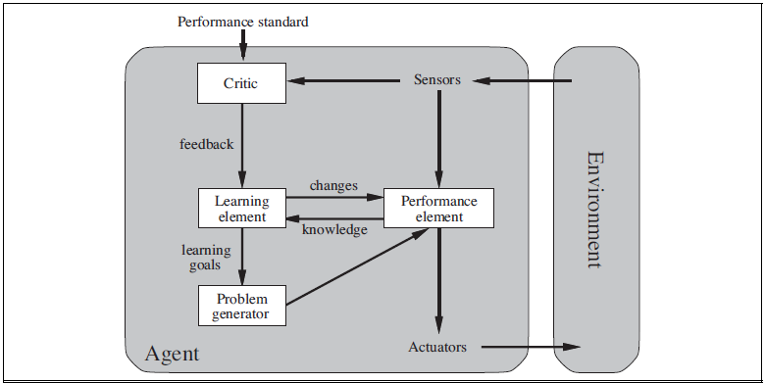
Learning Agents
A learning agent:
Has the ability to improve its capabilities.
May evolve into something initially unknown (in terms of knowledge, goals, etc.)

Slide 17
Types of Agents
There are 4 basic types of agents, with increasing complexity (and capability):
Simple reflex agents
Model-based reflex agents
Goal-based agents !
Utility-based agents !
In addition, there is another generalized type of agents, the Learning agents, which are capable of improving their performance through experience.

Slide 18
Search Agents

Slide 19
Reflex Agents vs Goal-Based Agents
A reflex agent:
Is simple, reactive, limited
Is merely a function mapping states into actions
A goal-based agent:
Has a high-level purpose, solves problems, may even involve planning
Takes into account the impacts of an action to future states
Ultimately aims to find a series of actions that lead to the goal
Is formalized into an agent that searches through solutions
Thus, “Search” Agents!

Slide 20
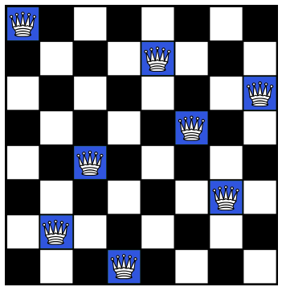
Goal-Based Agents: Example
A goal-based agent that solves the “8-Queen problem”
Place 8 queens on a chessboard such that no queen is attacking any other horizontally, vertically, or diagonally

Slide 21
Problem Formulation
The basic concept comes from a model-based agent
An agent that has a model / representation of the world
The world is modeled as “states”
A state can be seen as a snapshot of the world from the agent’s point of view
Depending on the problem, finding the solution can mean:
Finding a state that satisfies the requirements of the problem (a “goal” state)
Finding a sequence of actions that leads from an initial state to such a goal state
Technically a search problem through states

Slide 22
Problem Formulation
The set of all possible states is called the “state space”
The set of all possible actions is called the “action space”
States: How the world is represented in the agent’s point of view
Initial State: The state where the agent starts in
Actions: A set of actions the agent can take (based on the state the agent is in)
Transition Model: A description of how actions taken by the agent changes the states
Goal Test: Determines whether a state is a goal state
Path Cost: The cost that the agent suffers for doing an action in a given state

Slide 23
8-Queen Problem
States : Any arrangement of 0-8 queens on the board
Initial state : An empty board
Actions : Add queen, remove queen
Transition : Board updates model
Goal test : 8 queens on the board with none attacking each other
Path cost : 0 (it doesn’t matter how many moves are taken, as long as the solution is found)

Slide 24
Search Agents
The problems are properly formulated as states
A solution is either:
A state that satisfies the goal test
A sequence of actions that leads from the initial state to a state that satisfies the goal test
Finding the solution is a search through the states
How?
Search through all possible states (the entire state space)?
Search through the entire state-action space?

Slide 25
8-Queen Problem
State space: Any arrangement of 0-8 queens on the board
Number of all possible states:
64 possibilities for the first queen
63 possibilities for the second queen
…
#States = 64 * 63 * 62 * … * 57 ≈ 1.8 x 10¹⁴ states!
If 1 state requires 1 millisecond to evaluate, the whole state space requires … ?
This is the so-called “Brute-Force” search.
Guaranteed to find the solution, BUT ...

Slide 26
Search Tree
Brute-force search is simply not feasible in a lot of cases
More systematic search strategies are necessary
This is done by first constructing a Search Tree, which is a model of the sequence of actions through states
States serve as the nodes for the tree
Root node represents the initial state
Branches represent actions taken from a given state

Slide 27

4-Queen Problem
...
...
...
...
...
...

Slide 28
Search Technique
Uninformed Search
Informed Search

Slide 29
Uninformed Search
A search strategy where no domain knowledge (about the goal) is used
No information about the states beyond the problem definition (as opposed to Informed Search)
Also called “blind search”
Since there are no domain knowledge to be used, the idea is to explore the state space (via the search tree)

Slide 30
Uninformed Search
Uninformed search strategies:
Breadth-First Search (BFS)
Uniform-Cost Search (UCS)
Depth-First Search (DFS) We Learn This Today!
Depth-Limited Search (DLS)
Iterative Deepening Search (IDS)

Slide 31
Terminologies
The search space is divided into regions:
Explored (or “Closed List”, or “Visited Set”)
Frontier (or “Open List”, or the “Fringe”)
Unexplored
Essentially, searching means changing nodes of the search tree from unexplored into frontier into explored.
Different search strategies decide the order of such changes over the nodes.

Slide 32
Terminologies
Search strategies are evaluated and compared in the following ways:
Completeness: Does it always find the solution (if there is one)?
Optimality: Does it find the optimal solution?
An optimal solution is the solution with the least path-cost among other solutions
Time Complexity: How long does it take to find the solution?
Space Complexity: How much memory space is needed for the search?

Slide 33
Depth-First Search Strategies

Slide 34
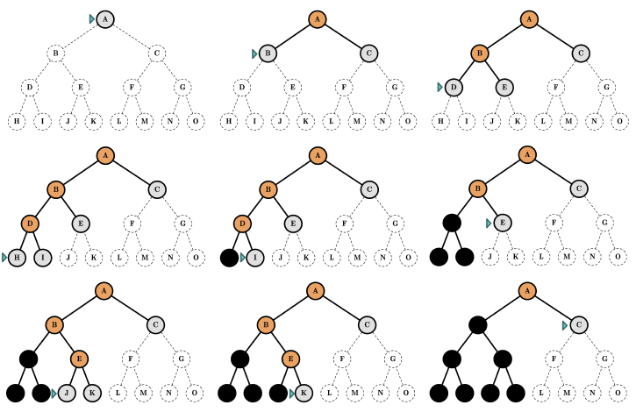
Depth-First Search: Mechanics

Slide 35
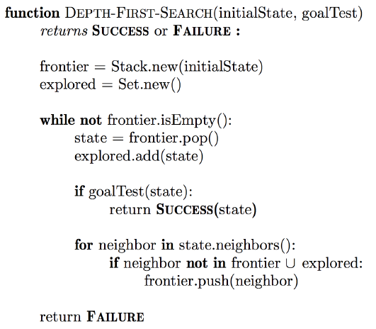
Depth-First Search: Algorithm

Slide 36
Depth-First Search: Analysis
Evaluation of the search strategy:
Completeness: No (on infinite-depth state spaces)
Optimality: No
Time complexity: Exponentially High
Space complexity: Linear (reasonably low!)
Only need to store a single path from root to leaf, plus unexpanded non-leafs
Implementation: Frontier is stored in a stack

Slide 37
Exercise !!

Slide 38
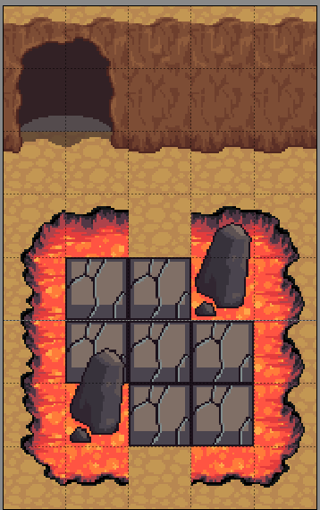
Goal: Go to Exit with all Cracked Path explored.
Action: Up, Down, Left, Right
Condition:
When Cracked Path explored, that tile become Magma and cannot be explore again!

Slide 39
Goal: Go to Exit with all Cracked Path explored.
Action: Up, Down, Left, Right
Condition:
When Cracked Path explored, that tile become Magma and cannot be explore again!

Slide 40
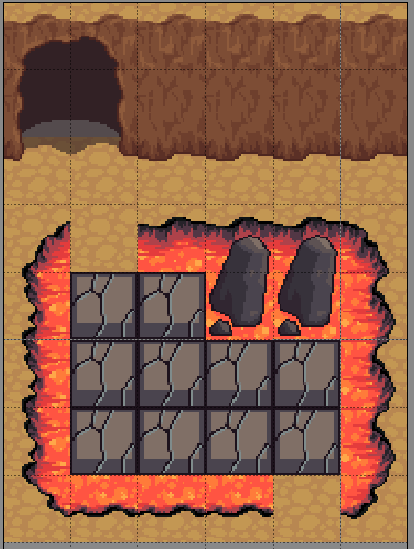
Goal: Go to Exit with all Cracked Path explored.
Action: Up, Down, Left, Right
Condition:
When Cracked Path explored, that tile become Magma and cannot be explore again!

Slide 41
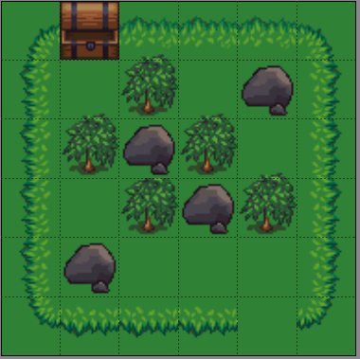
Goal:
Go to the Treasure Chest with Shortest Path!
Action: Up, Down, Left, Right
Condition:
Cannot go into tile with rock.
You can cut the tree with blade!
Your blade can only cut 2 Trees

Slide 42
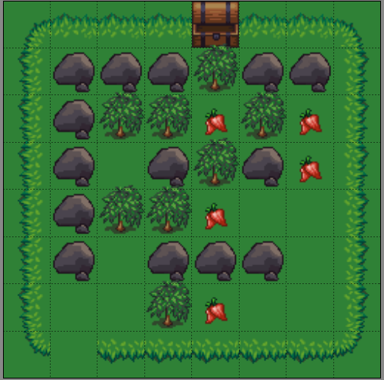
Goal:
Go to Treasure Chest with Shortest Path
Get as many berry!
Action: Up, Down, Left, Right
Condition:
Cannot go into tile with rock.
You can cut the tree with blade!
Your blade can only cut 3 Trees

Slide 43
Initial State:
You have 5 empty slots.
You have 8 card:
Red Card, Number 2
Blue Card, Number 4
Blue Card, Number 3
Red Card, Number 8
Red Card, Number 6
Blue Card, Number 5
Blue Card, Number 7
Red Card, Number 0
Goal:
Sequence Card so that:
No cards of the same color next to each other.
Each 2 card number is added and must produce a prime number

Slide 44
Thank you for listening

